Slide 1
Learn Python – Lesson 4
STEM Outreach

Slide 2
Agenda
Walk through Madlibs
Exercise Easy/Hard
Conditionals
Random Integer Guess
Trinket: https://hourofpython.trinket.io/a-visual-introduction-to-python#/if-else-statements/logical-turtles
For Loops
Trinket: https://hourofpython.trinket.io/a-visual-introduction-to-python#/repeating-with-loops-and-lists/lists-of-numbers
Olympic Rings
While Loops
Homework
Creating your second game: Rock Paper Scissors
Questions/Comments

Slide 3
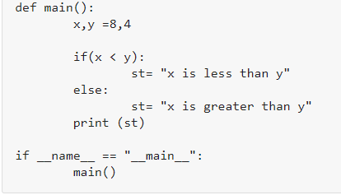
Conditionals
if expression:
Statement
else:
Statement
What if x and y are the same number?
Elif

Slide 4

Loops: For
In Python, "for loops" are called iterators.
Just like while loop, "For Loop" is also used to repeat the program.
But unlike while loop which depends on condition true or false. "For Loop" depends on the elements it has to iterate.

Slide 5
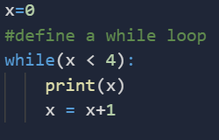
Loops: while
While loop does the exactly same thing what "if statement" does, but instead of running the code block once, they jump back to the point where it began the code and repeats the whole process again
while expression:
Statement
Variable x is set to 0
While loop checks for condition x<4. The current value of x is 0. Condition is true. Flow of control enters into while Loop
Value of x is printed
x is incremented by 1. Flow of control goes back to line 7. Now the value of x is 1 which is less than 4. The condition is true, and again the while loop is executed. This continues till x becomes 4, and the while condition becomes false.

Slide 6
Homework
Create a Rock Paper Scissors Game
Tips:
Import Random – will need a random string or integer choice to be chosen
Psuedo-Code:
Take your input
Get a random choice: Rock, Paper, Scissors
Check if yours and computer’s choices are the same, if not check rock beats scrissors
Else, paper beats rock
Else, scissors beats paper
Remember to ask if the user wants to play again

